Slide 1

USE OF ONTOLOGIES AND TERMINOLOGIES IN FHIR Roberta Gazzarata
InterHealth2022 – 12/10/2022 – Session 3.2

Slide 2


INTRODUCTION
Healthropy profile
We are a forward thinking innovator in medical informatics, and a spin-off partner with Genoa University, operating since 2014.
With our innovative technology HQuantum©, we propose an approach to realize the potential of Real World Data (RWD), building and enabling collaborative networks, making possible a system-wide approach to clinical data reuse in according to FAIR principles.
HQuantum©: cloud platform compliant to specific international standards which provides functionalities to:
Create and enable large collaborative networks of researchers focused on clinical data.
Automatically extract clinical data from their production source (ie. Hospital Information Systems) to enable data reuse.
Create and store structured clinical data using predefined standards and code systems.
Manage code systems and the associations among them.

Slide 3






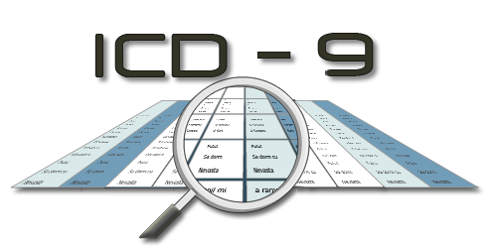

The context
What are Terminologies and Ontologies?
CodeSystems: sets of terms and expressions that designate the concepts and objects of a particular sector of knowledge or of a human activity and profession.
Defined at local level
Defined at national/international level
Eg. Local nomenclator for laboratory texts, for microorganisms, etc
Standard Code Systems

Slide 4
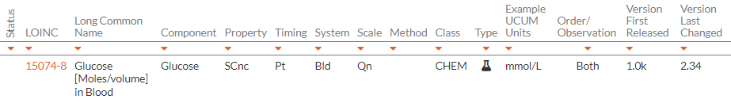
The context
HOW are represented the concepts?
Property
Code
(Id)
Display Name/Description

Slide 5





The context
Why are so important?
Twitter
Instagram

Slide 6
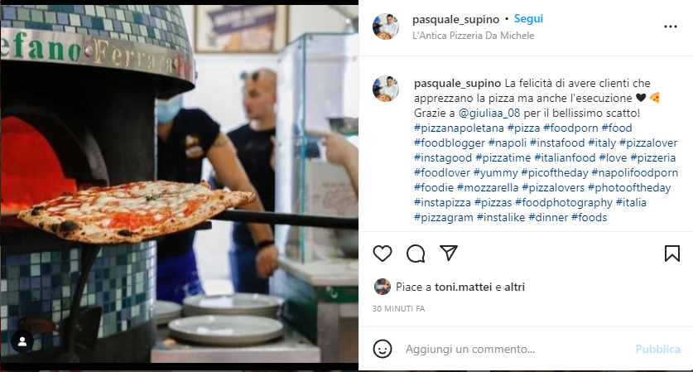





The context
Why are so important?
Mechanism to provide "meaning" to digital content through the association of "labels" to such content

Slide 7

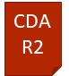
The context
Why are so important?
Observation
Code: Glic
CodeSystem: Lab X
Display: Glicemia
Version: 1.0
FHIR
Element to associate "labels" to resources/messages/documents

Slide 8
The context
Why are so important?
Twitter
Instagram
Repository
Code: Glic
CodeSystem: Lab X
Display: Glicemia
Version: 1.0
Thanks to these labels we can query a repository (ed. FHIR server)

Slide 9
The context
FOCAL POINTS
Terminologies/Ontologies (CodeSystems) are the labels to query repositories

Slide 10


The context
Why WE NEED Common Labels?
#TorinEurovision
#Eurovision2022
#2022Eurovision
#Songcontest2022

Slide 11
The context
standard terminologies ARE the common "labels"
The use of local terminologies in resources
Gluc
Glyc
Gl-01
XXX
Glyc
Glycemia
VS
The use of standardized terminologies in resources
14743-9
14743-9
14743-9
14743-9
14743-9
14743-9
14743-9
14743-9
Code: 14743-9
CodeSystem: LOINC

Slide 12
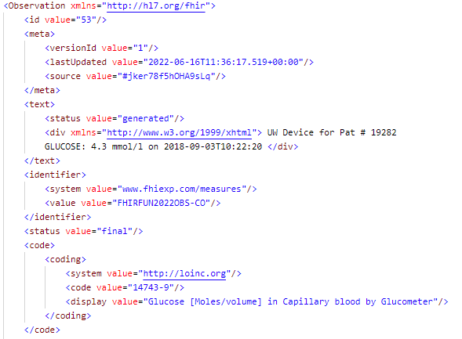
The context
standard terminologies ARE the common "labels"

Slide 13
The context
FOCAL POINTS
Terminologies/Ontologies (CodeSystems) are the labels to query repositories
Standard CodeSystems are necessary to enable to retreve all resources

Slide 14
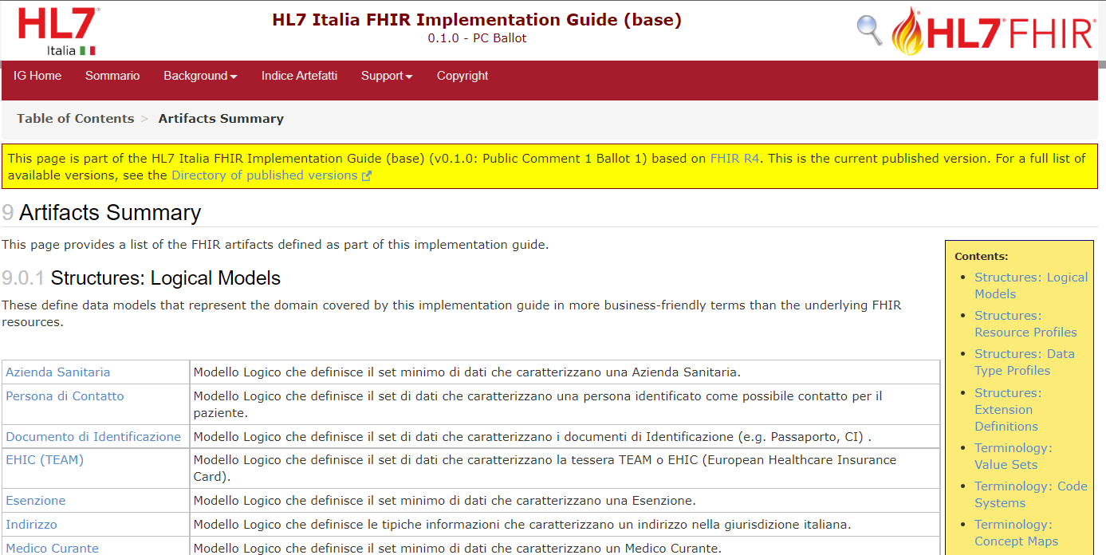
The context
THE NEED TO bind concepts of codesystem
ValueSet: set of values ​​belonging to one or more CodeSystems allowed for a given context

Slide 15
The context
FOCAL POINTS
Terminologies/Ontologies (CodeSystems) are the labels to query repositories
Standard CodeSystems are necessary to enable to retreve all resources
ValueSet allow to bind concepts in CodeSystems

Slide 16
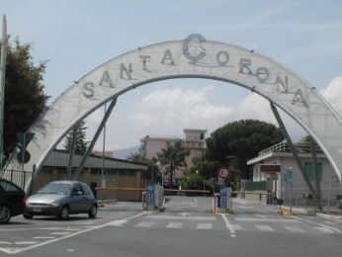
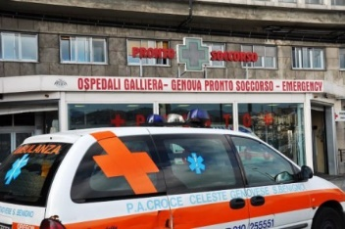
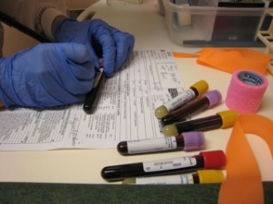
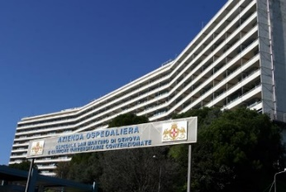
The context
THE NEED to map CONCEPTS FROM a codesystem to another
ConceptMap: declaration of relationship between concepts defined in different CodeSystems
Notes:
Analogamente se noi nelle risorse FHIR andiamo a usare etichette definite a livello locale quindi se lasciamo le terminologie locali sarà impossibile riuscire ad estrarre dall’FSE tutte le risorse FHIR prodotte da tutti i laboratori italiani che contengono valori di glicemia cosa invece più possibile se usiamo terminologie comuni quindi standard.

Slide 17
The context
Conceptmap features
One-way: from an "origin" concept to one or more "destination" concepts
Specific for a particular context of use (Domain)
It can concern the relationship between several concepts (a "source" and a "destination" valueset must be specified to constrain the context)
It has an Equivalence property that specifies the level of equivalence between source and target
Equivalence
TARGET
SOURCE
(concept o valueSet)
Equivalence
TARGET

Slide 18
The context
FOCAL POINTS
Terminologies/Ontologies (CodeSystems) are the labels to query repositories
Standard CodeSystems are necessary to enable to retreve all resources
ValueSet allow to bind concepts in CodeSystems
ConceptMas create assosiation of equivalence between concepts defined in different CodeSystems

Slide 19
The context
Problems in management of Codesystems, valuesets and concepmaps
Medicine evolution
Local and Standard CodeSystem Maintenance
ConceptMap Maintenance
December 2019
June
2020
December
2020
June
2021
August 2021
Febrary 2022
June
2022
V 2.67
V 2.68
V 2.69
V 2.70
V 2.71
V 2.72
V 2.73

Slide 20
The context
FOCAL POINTS
Terminologies/Ontologies (CodeSystems) are the labels to query repositories
Standard CodeSystems are necessary to enable to retreve all resources
ValueSet allow to bind concepts in CodeSystems
ConceptMas create assosiation of equivalence between concepts defined in different CodeSystems
CodeSystems, ValueSet and ConceptMas must be maintained over the time

Slide 21
Terminology service
purposes and features
Applications that centrally store terminology resources and provide access to them to client applications through operations:
Maintenance (create, update, delete)
Reading (even temporal queries)
They must be standardized (CTS2 - FHIR Terminology Service)
FHIR Terminology Service resources:
CodeSystems
ValueSets
ConceptMaps

Slide 22
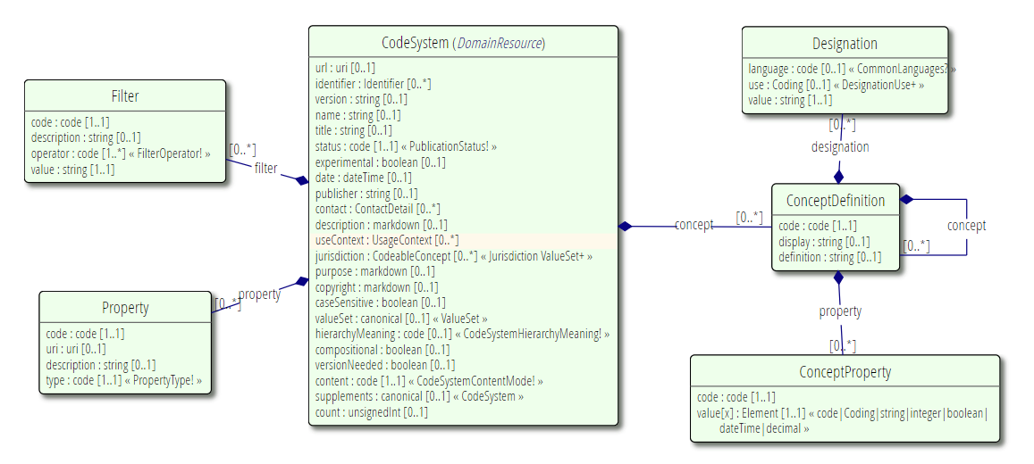
CODESYSTEM
UML Diagram

Slide 23
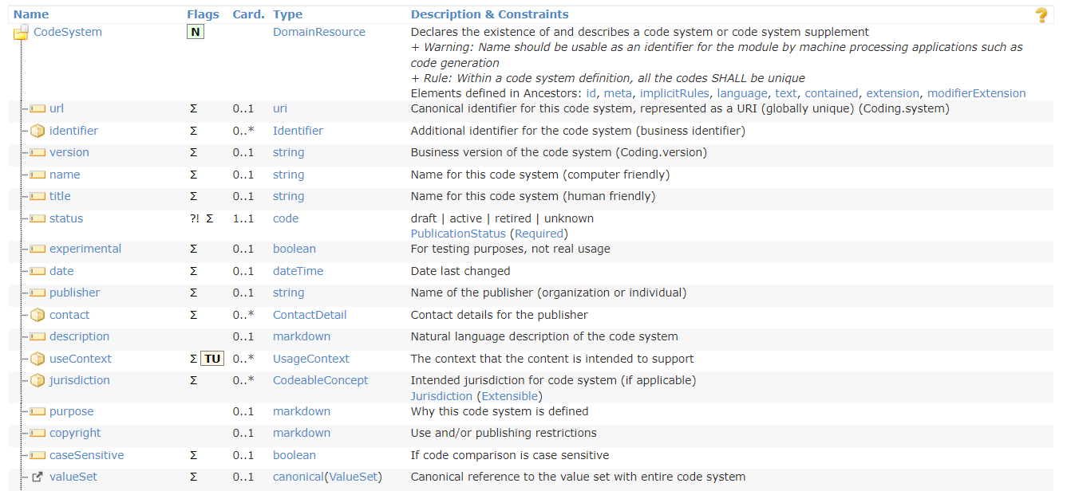
CODESYSTEM
STRUCTURE

Slide 24
CODESYSTEM
OperationS
$lookup: given a code/system, or a Coding, get additional details about the concept, including definition, status, designations, and properties
URL: [base]/CodeSystem/$lookup
EG. GET [base]/CodeSystem/$lookup?system=http://loinc.org&code=1963-8
$validate-code: validate that a coded value is in the code system
URL: [base]/CodeSystem/$validate-code
URL: [base]/CodeSystem/[id]/$validate-code
EG. GET [base]/CodeSystem/loinc/$validate-code?code=1963-8&display=test

Slide 25
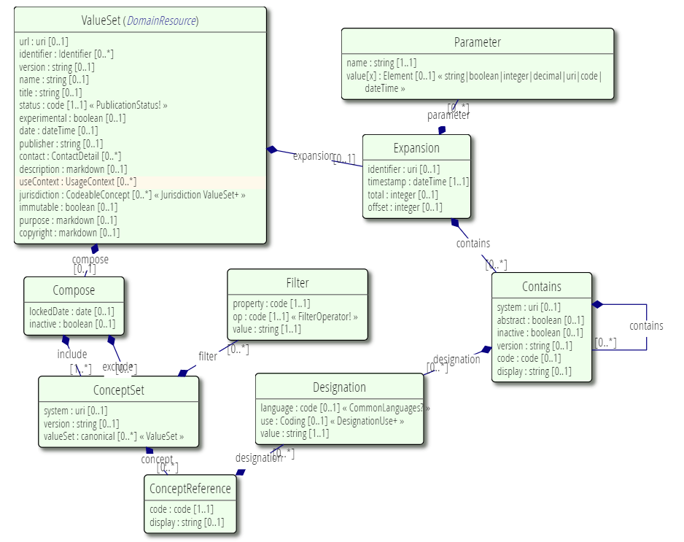
VALUESET
UML Diagram

Slide 26
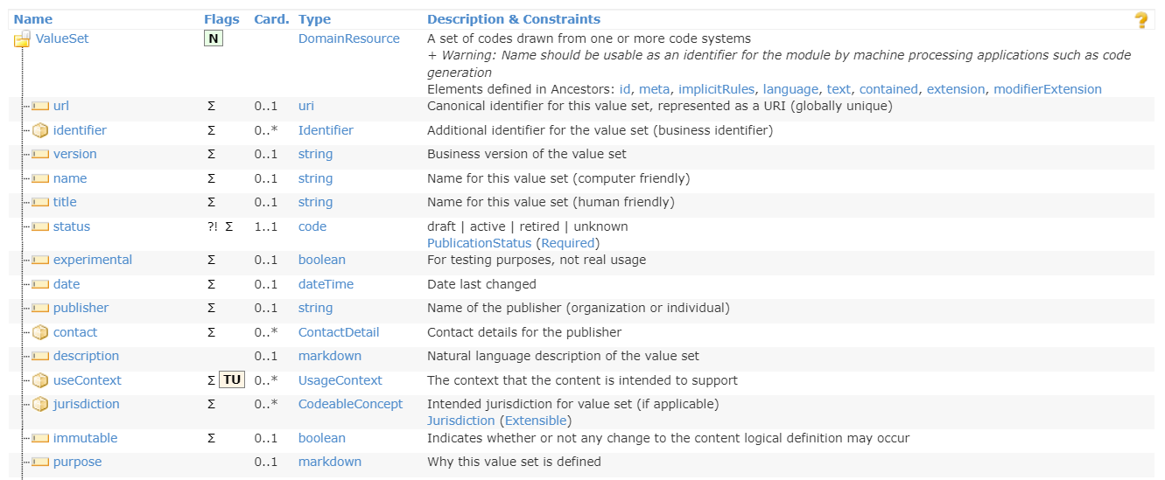
VALUESET
STRUCTURE

Slide 27
VALUESET
OperationS
$expand: given a value set, get all codes in valueset
URL: [base]/ValueSet/$expand
URL: [base]/ValueSet/[id]/$expand
EG. GET [base]/ValueSet/23/$expand?filter=abdo
$validate-code: Validate that a coded value is in the set of codes allowed by a value set.
URL: [base]/ValueSet/$validate-code
URL: [base]/ValueSet/[id]/$validate-code
EG. GET [base]/ValueSet/23/$validate-code?system=http://loinc.org&code=1963-8&display=test

Slide 28
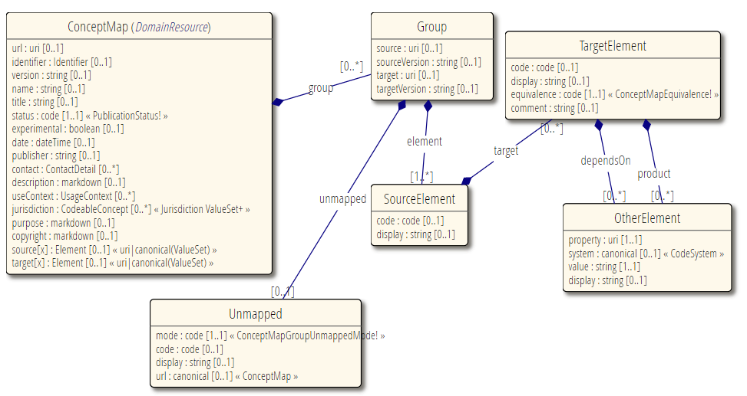
CONCEPTMAP
UML Diagram

Slide 29
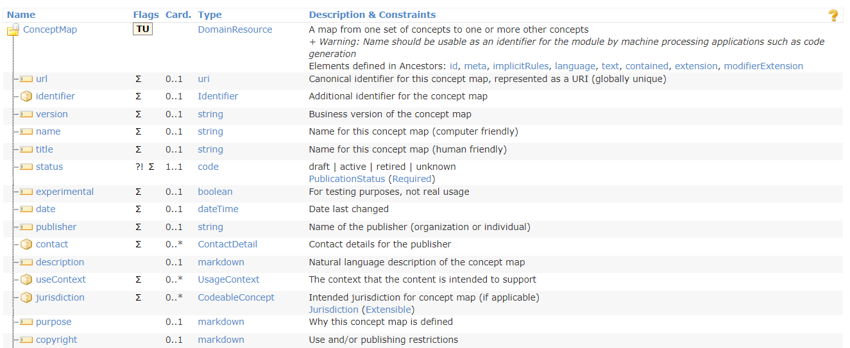
CONCEPTMAP
STRUCTURE

Slide 30
CONCEPTMAP
OperationS
$translate: translate a code from one value set to another, based on the existing value set and concept maps resources, and/or other additional knowledge available to the server
URL: [base]/ConceptMap/$translate
URL: [base]/ConceptMap/[id]/$translate
EG. GET [base]/ConceptMap/$translate?system=http://hl7.org/fhir/composition-status &code=preliminary&source=http://hl7.org/fhir/ValueSet/composition-status &target=http://hl7.org/fhir/ValueSet/v3-ActStatus

Slide 31

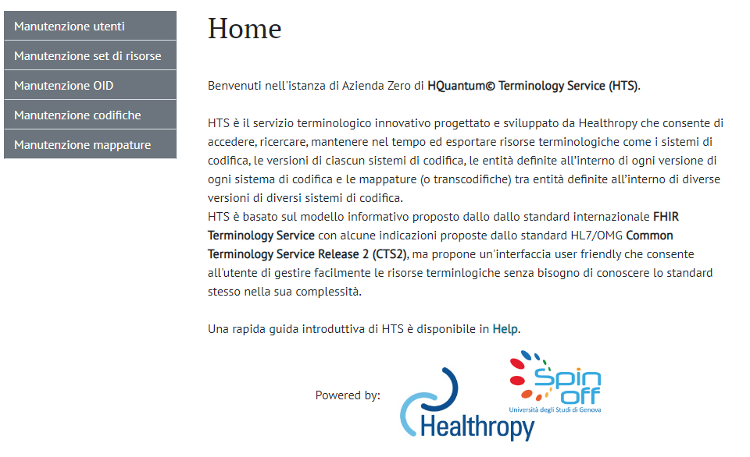
HQUANTUN© Terminology server
ARCHITECTURE
LIS
NO SQL DB
FHIR API
EHR
EMR

Slide 32

ThANKS for your attention!
Roberta Gazzarata
R&D Director and Co-founder
roberta.gazzarata@healthropy.it
3891506691

